Slide 2
VR Art Exhibition
VR
Educational Applications’ Evaluation
Development and Evaluation of Mixed Reality Educational Applications
MR(AR & VR) Chemistry Lab
AR
3D Coloring Game

Slide 3
Mixed Reality (MR)
Real
Environment
Augmented
Reality(AR)
Augmented
Virtuality (AV)
Virtual
Environment
Virtuality Continuum (VC)

Slide 4
Author | Essay topic | Gauge dimensions |  | Applicable people | Gauge features
Alvaro & Babette | Rubric for Assessing or Designing Digital Playful Learning Spaces(2001) | 7D | Fantasy space | Decision makers Parents Teachers Businesses Educators Developers | Emphasis is placed on the learning needs of users and less attention is paid to gameplay and entertainment. In the form of questions, it is a qualitative assessment
 |  |  | Feedback
 |  |  | Sense of control
 |  |  | Gamification learning curve
 |  |  | Special needs adaptability
 |  |  | Learning opportunities
 |  |  | Various educational opportunities
British Teacher Evaluation Education Media Organization | TEEM Teacher Evaluation Framework (2002) | 6D | Use profile | Teachers | The six dimensions altogether set up 37 questions and each question must be answered by complete sentences. Such evaluation is more rigorous and meticulous. In view of its focus on teachers’ teaching application, it belongs to qualitative evaluation
 |  |  | Course relevance
 |  |  | Design and navigation
 |  |  | Ease of use
 |  |  | Recreational
 |  |  | Installation

Slide 5
Author | Essay topic | Gauge dimensions |  | Applicable people | Gauge features
RICAR_DO JAVIER RADEMA CHER MENA | E/E Grid (EDU Grid &ENT Grid) (2010) | 2D | Educational property (taking Gardner multi-intelligence and “knowledge” dimension in 2001 Anderson education goal classification as specific indicators) | Game designer Teacher Educator | full account of the balance between educational and gameplay, using Caillois's game type classification is not very suitable for the types of games in modern educational games, and it is a qualitative evaluation
 |  |  | Game property (taking Battle virtual world player and Caillois game category as specific indicators)
Wang Wei(2009) | Multi-intelligence-based e-game education comprehensive evaluation index system | 3D | Tasks | Teacher Users Educational game development companies | 11 task boxes, 27 scene indicators and 25 interaction indicators. The classification of indicator is very refined with priority, which helps increase the preciseness of evaluation outcomes. It belongs to quantitative evaluation
 |  |  | Scenes
 |  |  | Interaction

Slide 6
Author | Essay topic | Gauge dimensions |  | Applicable people | Gauge features
Alvaro & Babette | Rubric for Assessing or Designing Digital Playful Learning Spaces(2001) | 7D | Fantasy space | Decision makers Parents Teachers Businesses Educators Developers | Emphasis is placed on the learning needs of users and less attention is paid to gameplay and entertainment. In the form of questions, it is a qualitative assessment
 |  |  | Feedback
 |  |  | Sense of control
 |  |  | Gamification learning curve
 |  |  | Special needs adaptability
 |  |  | Learning opportunities
 |  |  | Various educational opportunities
British Teacher Evaluation Education Media Organization | TEEM Teacher Evaluation Framework (2002) | 6D | Use profile | Teachers | The six dimensions altogether set up 37 questions and each question must be answered by complete sentences. Such evaluation is more rigorous and meticulous. In view of its focus on teachers’ teaching application, it belongs to qualitative evaluation
 |  |  | Course relevance
 |  |  | Design and navigation
 |  |  | Ease of use
 |  |  | Recreational
 |  |  | Installation
Author | Essay topic | Gauge dimensions |  | Applicable people | Gauge features
LEONAR D A. ANNET_TA, RICHAR DLAMB &MAR_CUS STONE | Serious Educational Game Rubric [SEGR] (2011) | 13D | Preface | Teachers, Game developers, etc. | It integrates educational property with game property. Kappa coefficient has been used to test every factor in the evaluation scale and accordingly improve reliability and validity. Through authentically combining education game with class teaching and students’ psychological characteristics, it comprehensively reflects teachers’ teaching demands. Every indicator (point 0, 1,2) belongs to quantitative evaluation
 |  |  | Tutorial
 |  |  | Interaction
 |  |  | Feedback
 |  |  | Identity
 |  |  | Happy / depressed
 |  |  | Sense of control
 |  |  | Degree of difficulty
 |  |  | Rules
 |  |  | Learning Content
 |  |  | learning target
 |  |  | Teaching effect
 |  |  | Communication channel

Slide 7
Pass the screenshot to the material of the object as a texture; Pass the parameters to Shader
Identification picture turn green; Call delay function
Identification picture is stable in the scan box
Y
Y
Scan the identification picture
Identification picture is in the scan box
N
Stop the delay function
N
Identification picture turn red

Slide 8
Identification map turn green
Click the Earth Model
Y
Identification picture is in the scan box
The Earth model rotate
Scan the identification picture
Click the Earth model
N
Identification map turn red
Show the Solar system

Slide 9
a
c
e
b
d
r
g
h

Slide 10
targetAnglePoint1
（-X/2,Y/2,0）
targetAnglePoint3
（X/2,Y/2,0）
P_Point1
P_Point3
（0,0,0）
P_Point2
P_Point4
targetAnglePoint2
（-X/2,-Y/2,0）
targetAnglePoint4
（X/2,-Y/2,0）

Slide 11
U_Point1
U_Point3
P_Point1
P_Point3
P_Point2
P_Point4
U_Point2
U_Point4

Slide 12
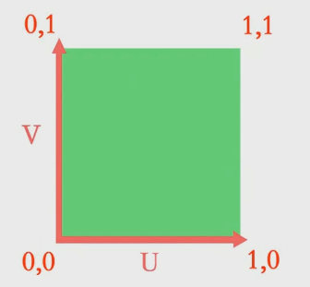
（0,1）
（1,1）
V
（0,0）
U
（1,0）

Slide 13
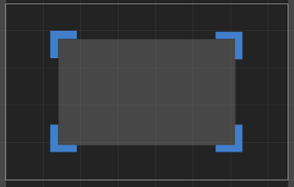
（0，600）
（800，600）
Y
（800，0）
（0，0）
X

Slide 14
Color the picture 2
Scan the picture 2 with camera
Show the 3D model

Slide 15

Success

Slide 16
AR 显示
识别图制作
获取屏幕截图
将获取的贴图贴到模型上
Vuforia 网站上传识别图，然后下载包导入Unity3d
UV 拆分和匹配
显示模型制作
贴图坐标计算
Shader 值传递
Photoshop
Maya/3D max
Unity 3D
Mobile Devices

Slide 17
Upload the target pics to Vuforia and import the Unity package to Unity3d
Get the Screen capture
Attach the captured map to the model
AR Display
Target pictures
UV Split & match
Models
Mapping coordinates
Pass the Shader value
Photoshop
Maya/3D max
Unity 3D
Mobile Devices

Slide 18
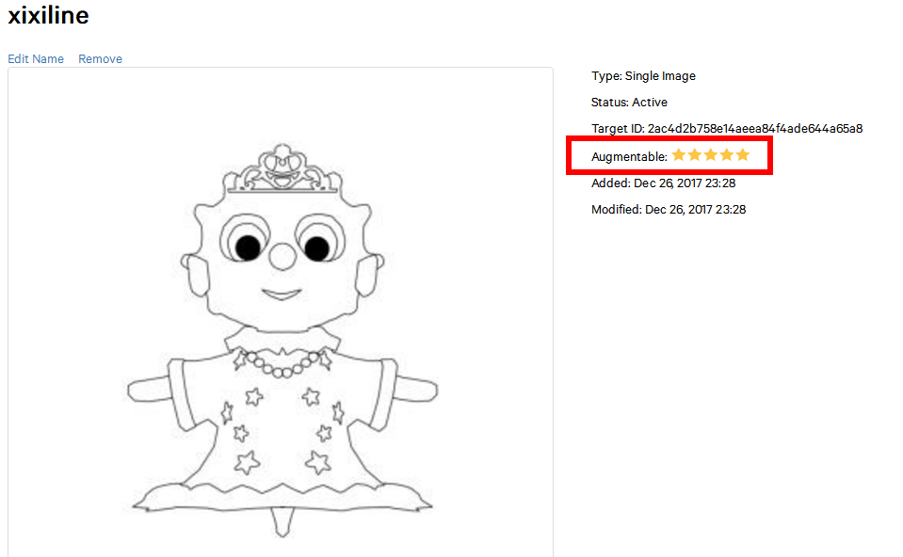
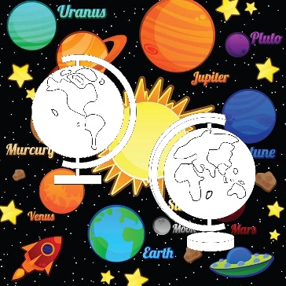

Slide 19
Experiment 1: Magnesium ribbon combustion
Experimental equipment
Magnesium ribbon, asbestos net, beakers, goggles, vinegar

Slide 20
Experiment steps
Read the guidelines on the desk, or watch videos
Grab the match on the desk and Lighting alcohol lamp
Grab one of the two magnesium ribbons on the desk and burn it on the fire
Watch and record the phenomenon
Put the burned magnesium ribbon into the beaker containing vinegar, put another(unburned) magnesium ribbon into another beaker containing with vinegar
Watch and record the phenomenon
Extinguishing alcohol lamp by putting the cover on it
Back to the Main scene by clicking the back button

Slide 21
Experiment phenomena
The magnesium ribbon emits dazzling white light when burned, releasing a lot of heat and producing a white solid
The beaker placed in the burned magnesium ribbon has no reaction
the magnesium ribbon in The other beaker dissolves gradually and generates bubbles

Slide 22
Experimental theory
2Mg+H2O+CO2+O2——Mg2(OH)2CO3
2Mg+O2 — Ignite — 2MgO
Mg + 2CH3COOH —— (CH3COO)2Mg + H2( ↑ )

Slide 23
